Slide 1








Welcome to the 2024 VENTURA
Showcase Event
Virtual Decision Rooms for Water Neutral Planning
Digital Sustainable Societies

Slide 2
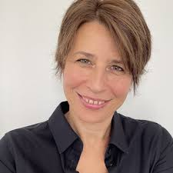
2024 VENTURA Showcase Event
Welcome and introduction to VENTURA
10.00-10.15
Ana Mijic
Reader in Water Systems Integration
VENTURA Principal Investigator

Slide 3
Purpose of the Showcase event and plan for the day
VENTURA: Virtual Decision Rooms for Water Neutral Planning

Slide 4

Purpose of the Showcase event and plan for the day
VENTURA: Virtual Decision Rooms for Water Neutral Planning
Explain and demonstrate the work done during the 2-year VENTURA project
SYSTEMS
THINKING
MODELLING
DIGITAL
ENGAGEMENT
Get your input where we should be taking the work next from multiple perspectives:
(1) Integrated Water Management
(2) Water Neutrality and Systems Thinking
(3) Digital Tools for Decision Making
Local government
Water companies
Regional and national policy
Consultancies
Academia

Slide 5
Purpose of the Showcase event and plan for the day
VENTURA: Virtual Decision Rooms for Water Neutral Planning
10.00 | Welcome note by Ana Mijic, VENTURA Principal Investigator
10.15 | Keynote by Luke Ridley, DEFRA Water Science Lead
10.40 | Theme 1. Integrated water management for land use planning. Chair: Darren Beriro
10.45 | Group activity: Exploring integrated water management
11.15 | Panel discussion: Luke Ridley, David Hodcroft, Matt Whaley, Ana Mijic
11.35 | Coffee break
11:55 | Theme 2: Systems-based approaches. Chair: Nici Zimmermann
12.00 | Koko Zhou: Participatory systems dynamics in Greater Manchester
12.15 | Barnaby Dobson: Integrated water system modelling in the Upper ￼Mersey
12.30 | Group activity: Exploring water neutrality for you and your organisation from a systems perspective
13.00 | Lunch

Slide 6
Purpose of the Showcase event and plan for the day
VENTURA: Virtual Decision Rooms for Water Neutral Planning
14.00 | Keynote by David Hodcroft, GMCA, Infrastructure Lead
14.30 | Theme 3. Governance and digital solutions. Chair: Ana Mijic
14.35 | Darren Beriro: VDR co-design and development
14.40 | Eduardo Rico Carranza: Virtual Decision Room Demonstration
15.10 | Coffee break
15.20 | Group activity: How do digital tools support decision making
15.45 | Feedback and closing remarks by the VENTURA team
16.00 | Drinks reception
17.00 | Event closes

Slide 7
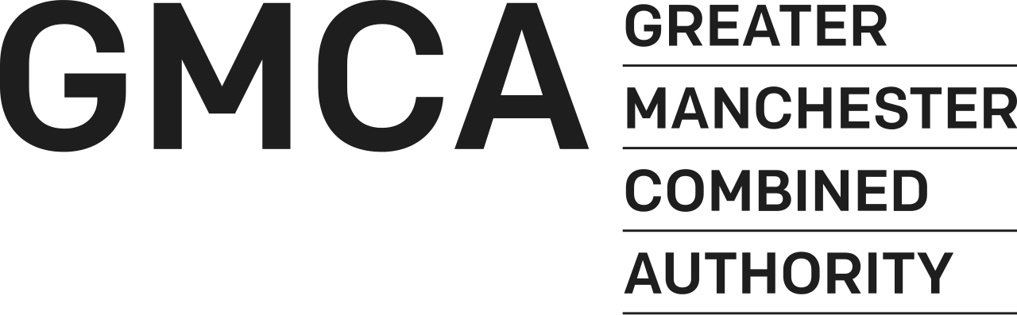

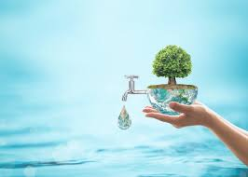


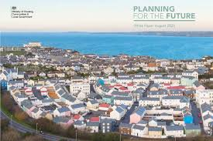




VENTURA project was developed from a need to provide support for integrated water planning using digital, integrated platforms and collaborative solutions
Infrastructure physical system
(land and water)
Governance and
management
Planning guidelines and
management options

Slide 8
VENTURA project was developed from a need to provide support for integrated water planning using digital, integrated platforms and collaborative solutions
Infrastructure physical system
(land and water)
Governance and
management
Planning guidelines and
management options for
water neutral developments
Digital Sustainable Societies

Slide 9
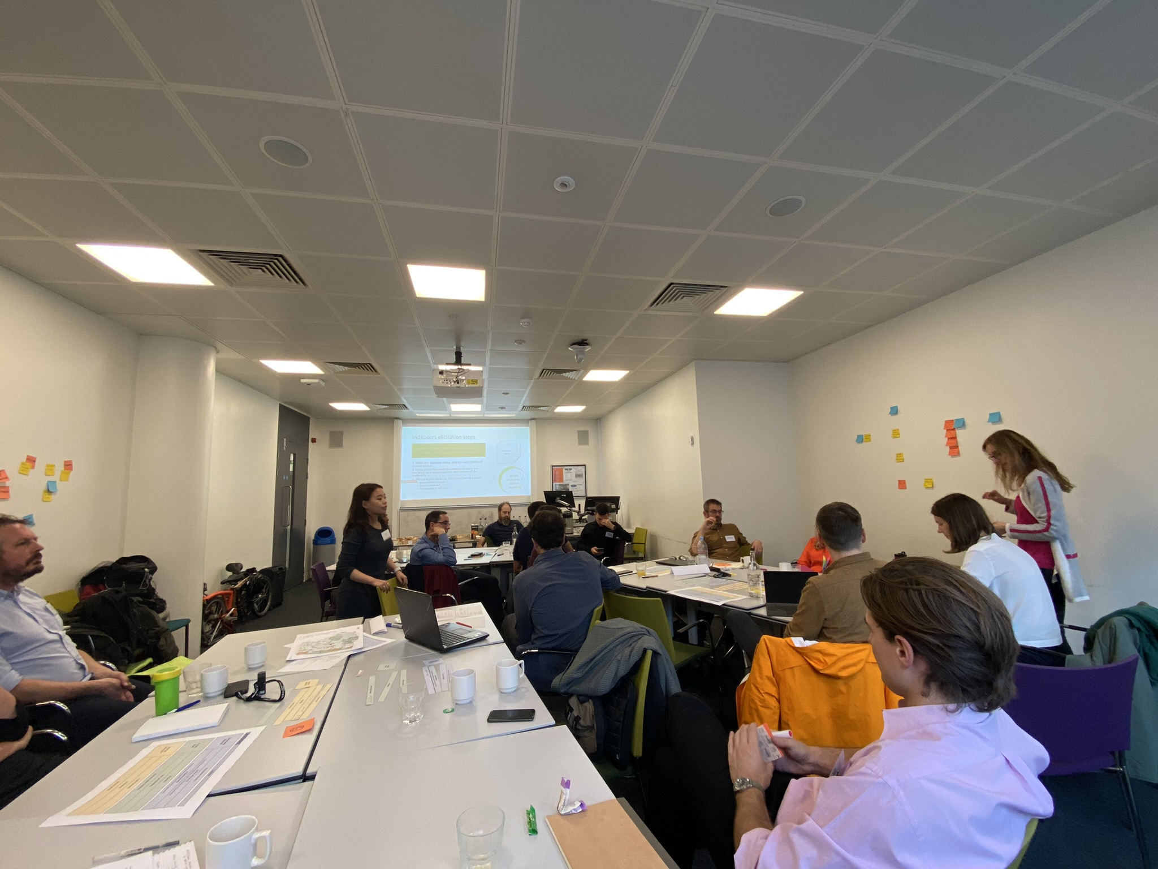
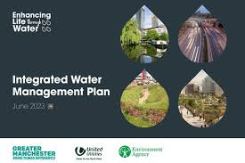
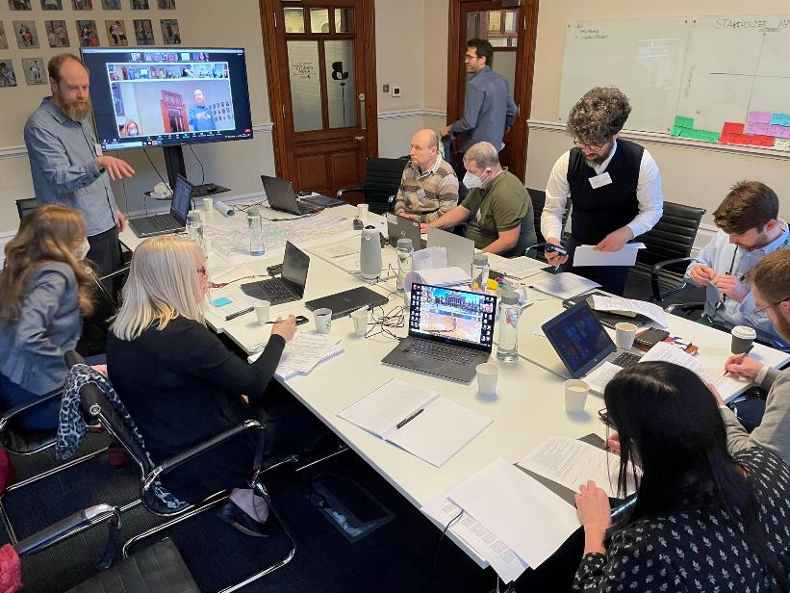


Two project case studies: Integrated water strategy for Greater Manchester and Integrated planning for Enfield Borough
MANCHESTER
ENFIELD
Introducing digital tools to manage multiple datasets efficiently and reduce the time required to produce local plans.
Facilitate decision-making when confronted with complexities in water neutrality and urban developments.
GMCA, UU and EA Trilateral agreement
Focus of the Showcase event is on Greater Manchester case study, but please come and talk to the team about Enfield work!

Slide 10
VENTURA maximises the value of quantitative evidence by creating a platform that will support collaborative decisions on water neutral planning informed by systems thinking

Slide 11
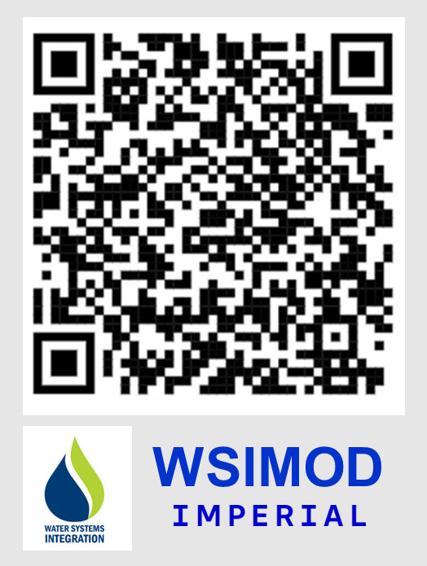


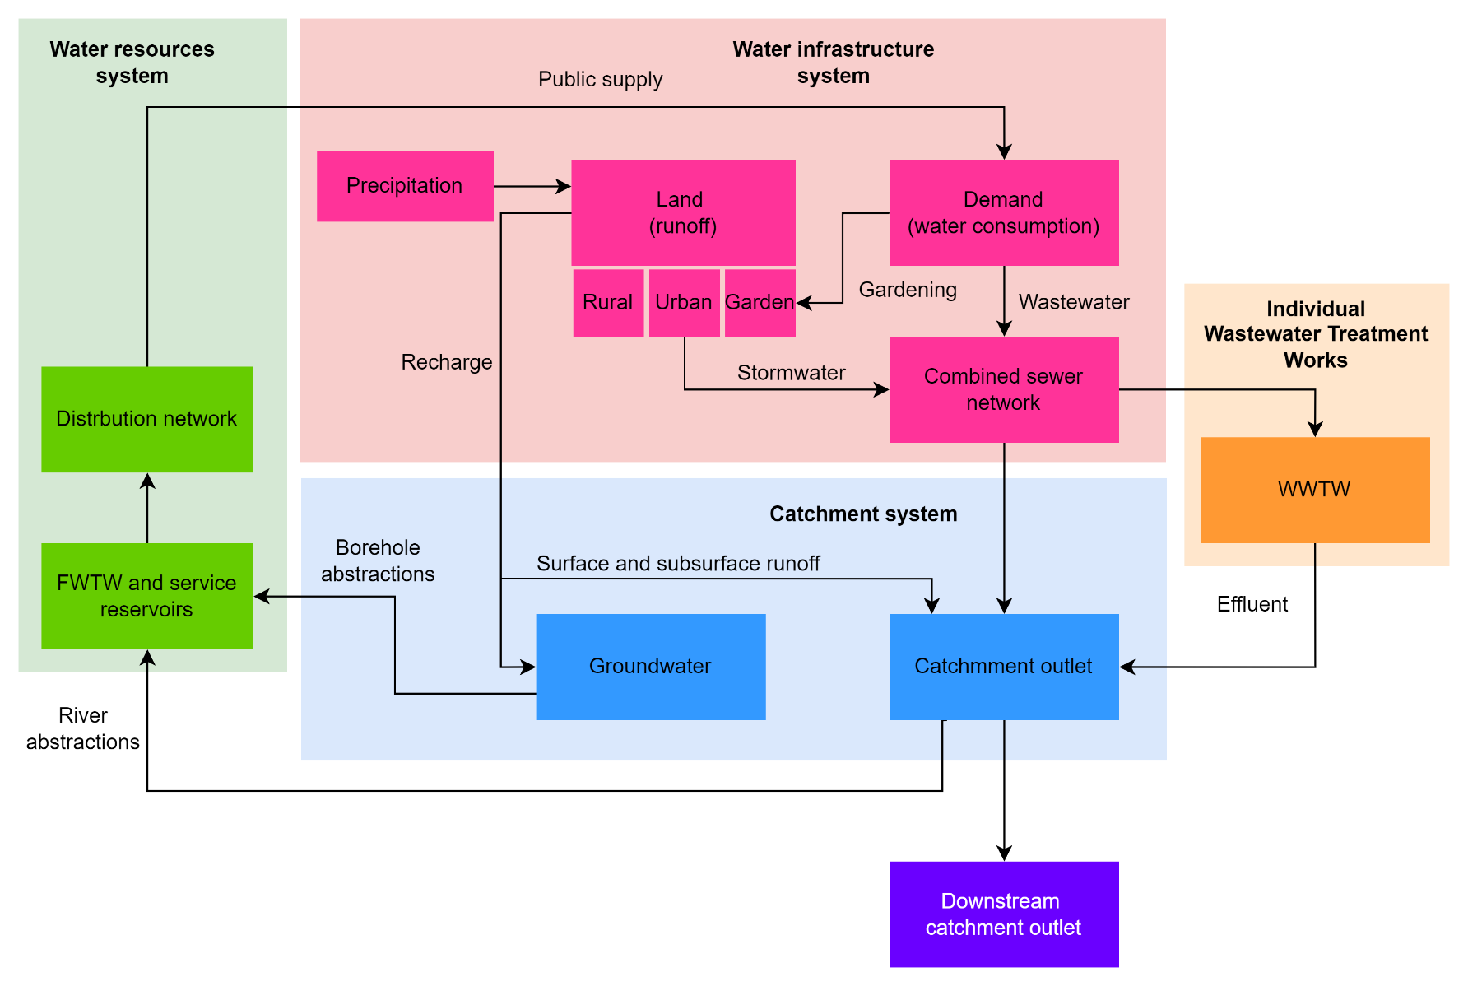
VENTURA maximises the value of quantitative evidence by creating a platform that will support collaborative decisions on water neutral planning informed by systems thinking
Providing evidence on water neutrality through the integrated water system model
DI
WN
TG
BASELINE
DI = direct impact
WN = water neutrality
TG = target

Slide 12
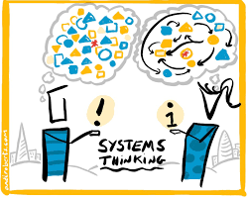
VENTURA maximises the value of quantitative evidence by creating a platform that will support collaborative decisions on water neutral planning informed by systems thinking
Providing evidence on water neutrality through the integrated water system model
Understanding how evidence could be used in a collaborative way to inform integrated water strategies
DI
WN
TG
BASELINE
DI = direct impact
WN = water neutrality
TG = target

Slide 13
VENTURA maximises the value of quantitative evidence by creating a platform that will support collaborative decisions on water neutral planning informed by systems thinking
Providing evidence on water neutrality through the integrated water system model
Understanding how evidence could be used in a collaborative way to inform integrated water strategies
Virtual Decision Room (VDR) designed to enable water neutral analysis for VENTURA partners
DI
WN
TG
BASELINE
DI = direct impact
WN = water neutrality
TG = target

Slide 14
We have started with three discipline-led workflows which include activities needed to develop the final VDR prototype
SEP 2021
WSIMOD setup
API development
WSIMOD + VDR
final WSIMOD
spatial
domain
VDR
workflows
VDR
prototype
VDR
testing
SEP 2023
final VDR
problem
formulation
CLD development
CLD + VDR
final
CLD
VDR = Virtual Decision Room
API = Application Programming Interface
CLD = cause and loop diagram

Slide 15
During the project, we realised that we need a separate engagement workflow that will link the project in a transdisciplinary way
SEP 2021
WSIMOD setup
API development
WSIMOD + VDR
final WSIMOD
spatial
domain
VDR
workflows
VDR
prototype
VDR
testing
SEP 2023
final VDR
problem
formulation
CLD development
CLD + VDR
final
CLD
scoping
workshops
VDR
workshops
CLD
workshops
VDR
feedback
VDR use
SHOWCASE
VDR = Virtual Decision Room
API = Application Programming Interface
CLD = cause and loop diagram

Slide 16
And we have integrated all processes into the VENTURA framework that you will hear about more from the team
API development
DIGITAL = VDR
WSIMOD setup
WSIMOD + VDR
final WSIMOD
spatial
domain
VDR
workflows
VDR
prototype
VDR
testing
final VDR
problem
formulation
CLD development
SYSTEMS
THINKING
CLD + VDR
final
CLD
Dr Koko Ke
scoping
workshops
VDR
workshops
CLD
workshops
VDR
feedback
VDR use
SHOWCASE
ENGAGEMENT
VDR = Virtual Decision Room
API = Application Programming Interface
CLD = cause and loop diagram

Slide 17
And we have integrated all processes into the VENTURA framework that you will hear about more from the team
API development
DIGITAL = VDR
WSIMOD setup
WSIMOD + VDR
final WSIMOD
spatial
domain
VDR
workflows
VDR
prototype
VDR
testing
final VDR
problem
formulation
CLD development
MODELLING
SYSTEMS
THINKING
CLD + VDR
final
CLD
Dr Barney Dobson
Dr Koko Ke
scoping
workshops
VDR
workshops
CLD
workshops
VDR
feedback
VDR use
SHOWCASE
ENGAGEMENT
VDR = Virtual Decision Room
API = Application Programming Interface
CLD = cause and loop diagram

Slide 18
And we have integrated all processes into the VENTURA framework that you will hear about more from the team
API development
DIGITAL = VDR
WSIMOD setup
WSIMOD + VDR
final WSIMOD
Dr Eduardo Rico
Dr Darren Beriro
spatial
domain
VDR
workflows
VDR
prototype
VDR
testing
final VDR
problem
formulation
CLD development
MODELLING
SYSTEMS
THINKING
CLD + VDR
final
CLD
Dr Barney Dobson
Dr Koko Ke
scoping
workshops
VDR
workshops
CLD
workshops
VDR
feedback
VDR use
SHOWCASE
ENGAGEMENT
VDR = Virtual Decision Room
API = Application Programming Interface
CLD = cause and loop diagram

Slide 19

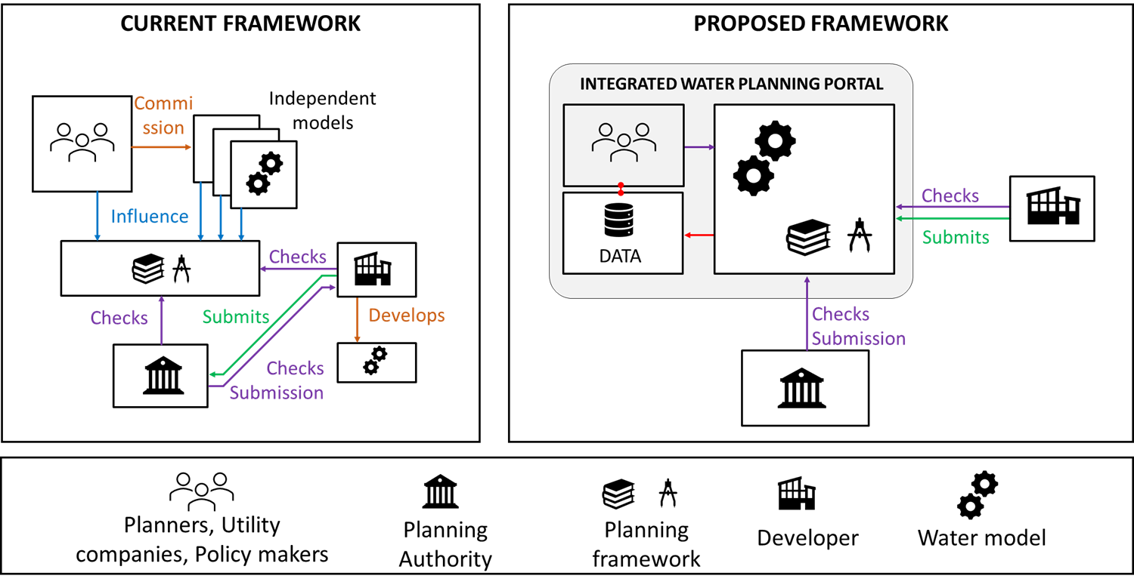
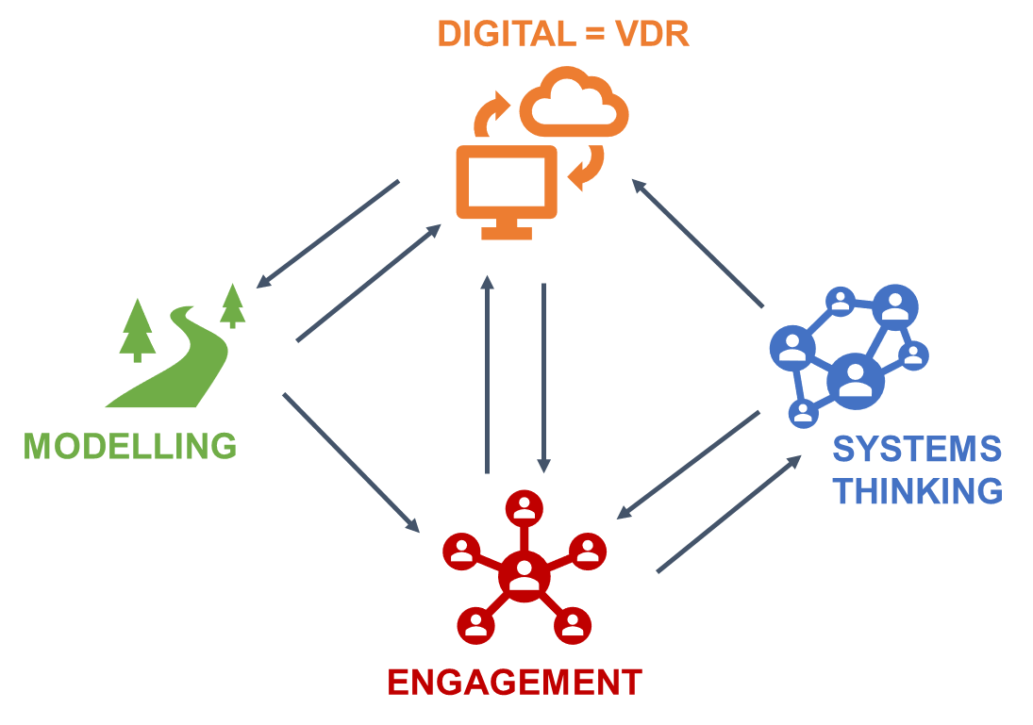
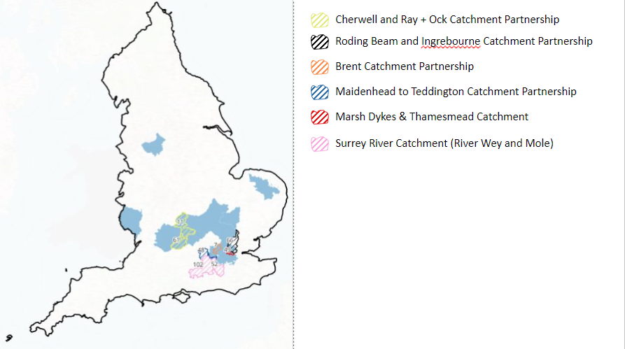
We are very excited to be taking the work forward in multiple ways…
VENTURA blueprint
INTEGRATED WATER PLANNING PORTAL (IWPP)
An accessible and standardised digital platform for an efficient and sustainable planning application process in the context of water neutrality
Will finish in Sep 2024
To communicate a need for the whole-systems collaborative approach/process and use of evidence for, in this case, water neutrality assessment using a digital tool
Due to be published by the end of 2024
Scoping study on collaborative catchment planning using WSIMOD and digital platforms
April – September 2024
WSIMOD VDR for CaBA
VENTURA team
Dr Eduardo Rico
Dr Ziyan Zhang

Slide 20
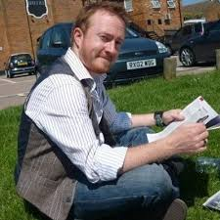
2024 VENTURA Showcase Event
Keynote presentation
10.15-10.40
Luke Ridley
DEFRA Water Science Lead

Slide 21


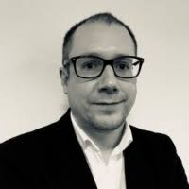
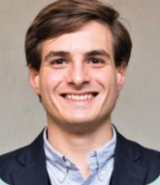
Theme 1. Integrated water management (IWM) for land use planning
Chair: Darren Beriro
10:40 – 11.35
Aim: Understand shared perspectives on what IWM means to the room and how this is supported by policies at different geographical scales
Group activity. Exploring Integrated Water Management (30 minutes)
Panel discussion (20 minutes)

Slide 22
2024 VENTURA Showcase Event
Group activity. Exploring Integrated Water Management
10.45-11.15
Plan for the activity:
[5 mins] Briefly introduce yourselves to one and other (e.g., organisation, role, interest in IWM)
[2 + 8 mins] Discuss what IWM means to you and your organisation – use post it notes to write down your definition and then present it to the group
[10 mins] Once you have an understanding of each other’s perspectives, explore similarities and differences between these and note key challenges
[5 mins] Based on your discussion, prepare 1-2 questions for the panel

Slide 23
Questions for panel:
Where do you see a key link between the IWM and implementation challenges with respect to water plans, strategies and/or policies?

Slide 24
2024 VENTURA Showcase Event
Panel discussion
11.15-11.35
Integrated water management (IWM) for land use planning

Slide 25




2024 VENTURA Showcase Event
Coffee break
11.35-11.55

Slide 26
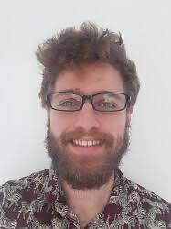

Theme 2. Systems-based approaches approaches
Chair: Nici Zimmerman
10:55 – 13.00
Aim: Provide an overview of the systems thinking research and modelling conducted as part of the VENTURA project
Research presentations (30 minutes)
Group activity: Exploring water neutrality for you and your organisation from a systems perspective (30 minutes)

Slide 27
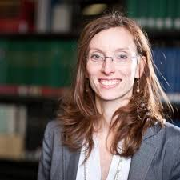
2024 VENTURA Showcase Event
Systems-based approaches
Nici Zimmerman
Professor of System Dynamics
VENTURA Co-Investigator

Slide 28
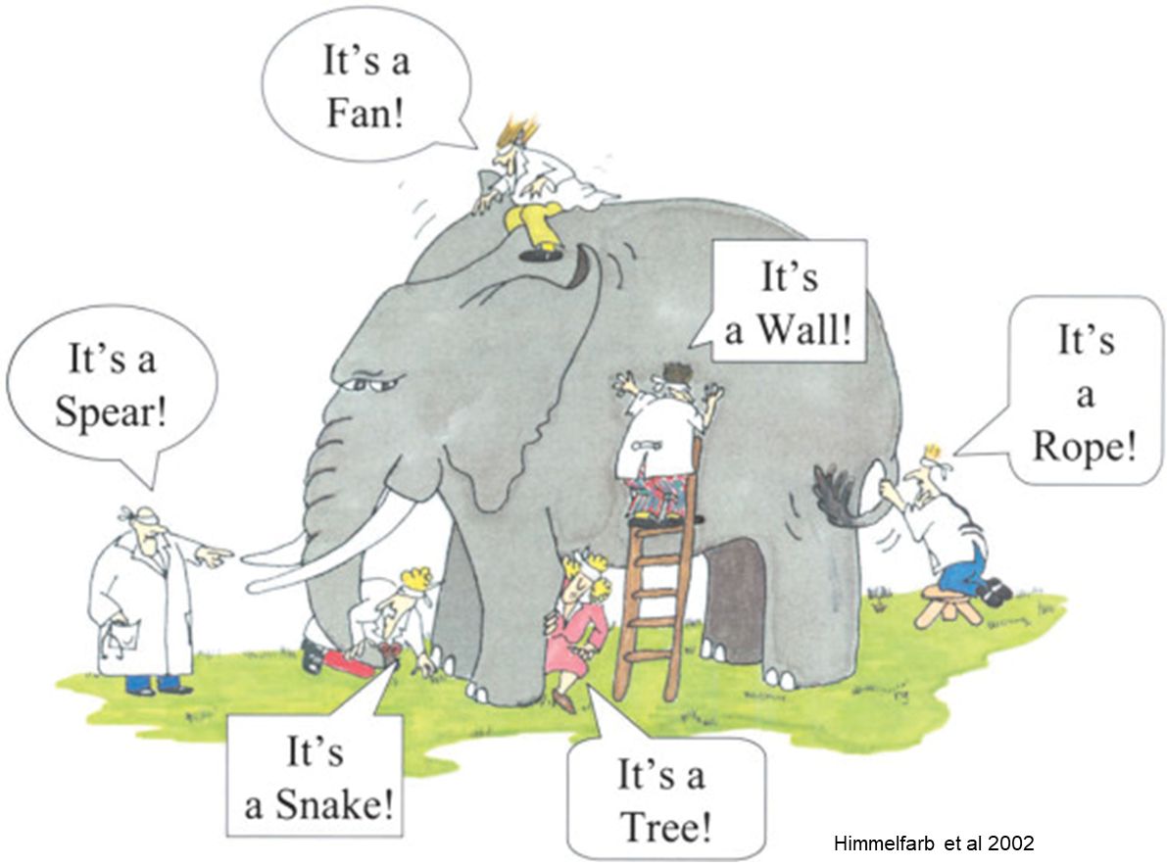
Systems-based approaches
Systems engineering
Systems thinking
System of systems perspective
Life cycle perspective
Requirements/needs focus
System design purpose
Wholes rather than parts
Everyone’s perspectives - participatory engagement
World viewed from the perspective of a problem, not of a system
Problem → causes → solutions
Notes:
Difficulty of finding an owner
Understanding function is important in ST

Slide 29
Systems thinking Participatory system dynamics in Manchester and Enfield
Workshops and/or interviews with institutional stakeholders
Individual or joint mapping of the perceived elements relevant to a problem
Visualisation in word-and-arrow diagrams e.g. Causal Loop Diagrams: system perception → action → system perception → action
Notes:
Engagement with institutional stakeholders over several months in workshops and/or interviews
emphasising feedback loops how we react on the system and our actions create the next state of the system

Slide 30
Systems modelling Water Systems Integration Modelling Framework (WSIMOD) in the Upper ￼Mersey
Integrated modelling of flow and water quality indicators using WSIMOD
Modelling across the boundaries of institutional responsibilities
Preparing scenarios for VDR implementation

Slide 31
Theme 2. Systems-based approaches
System thinking and integrated water system modelling presentations (30 minutes)

Slide 32
2024 VENTURA Showcase Event
Group activity. Exploring water neutrality for you and your organisation from a systems perspective
12.30-13.00
Water neutrality (WN) is one of many potential policies that can support IWM. We would like to explore what WN means to you and your organisation. We will use this information to check against our assumptions in developing the platform.
Plan for the activity:
[5 mins] Individually, on post it notes, write down what WN means to and your organisation.
[11 mins] Discuss how WN is or might be in the future operationalised in your organisation or by wider society/policy and select two key points for discussion.
[7 tables x 2 mins = 14 mins] Share two key points in plenary feedback.
DI
WN
TG
BASELINE
DI = direct impact
WN = water neutrality
TG = target

Slide 33




2024 VENTURA Showcase Event
Lunch break
13.00-14.00

Slide 34

2024 VENTURA Showcase Event
Keynote presentation
14.05-14.30
David Hodcroft
GMCA, Infrastructure Lead
VENTURA Project Partner
Enhancing life though water: a new way of managing water in Greater Manchester

Slide 35
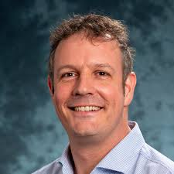
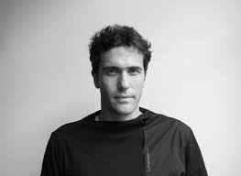
Theme 3. Governance and digital solutions
Chair: Ana Mijic
14.30-15.45
Aim: Explain the development of the VENTURA VDR, demonstrate the VDR prototype and get the feedback about the potential future VDR developments
VDR co-design, development and demonstration (40 minutes)
Coffee break (10 minutes)
Group activity: How do digital tools support decision making (25 mins)

Slide 36
Theme 3. Governance and digital solutions
VDR co-design, development and demonstration (40 minutes)

Slide 37
2024 VENTURA Showcase Event
Coffee break
15.10-15.20

Slide 38
2024 VENTURA Showcase Event
Group activity. How do digital tools support decision making
15.20-15.45
Plan for the activity:
[5 mins] Discuss and choose one key points from the previous group activity that could be addressed by evidence provided by a VENTURA-type VDR interface.
[13 mins] Map 2-4 aspects of the selected WN challenge that a VDR could help improve and how. Choose one key aspect for discussion.
[7 tables x 1 minute = 7 minutes] Share one key aspect in plenary feedback.

Slide 39
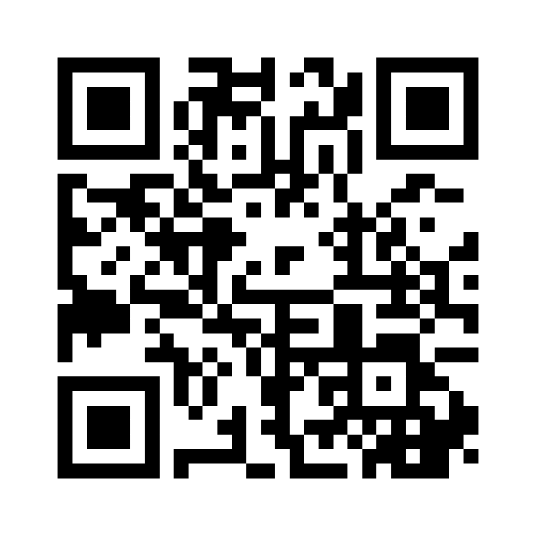
2024 VENTURA Showcase Event
Informing VENTURA future
15.45-15.50
Mentimeter input to answer 3 questions that will help us shape future work and events:
Q1. Write one thing you learnt today you didn’t know this morning.
Q2. Write one thing you really enjoyed about the day.
Q3. Write one thing you would like to improve for future similar events.
Please go to menti.com and use the code 6658 6627 or scan the QR code

Slide 40
2024 VENTURA Showcase Event
Closing remarks
15.50-16.00

Slide 41
THANK YOU!
2024 VENTURA Showcase Event
Virtual Decision Rooms for Water Neutral Planning
Digital Sustainable Societies

Slide 42
Extra slides

Slide 43
VENTURA Framework
DIGITAL = VDR
MODELLING
SYSTEMS
THINKING
ENGAGEMENT

Slide 44
We have started with three discipline-led workflows which include activities needed to develop the final VDR prototype
SEP 2021
WSIMOD setup
API development
WSIMOD use
WSIMOD + VDR
final WSIMOD
spatial
domain
VDR
workflows
VDR
prototype
VDR
testing
SEP 2023
VDR use
final VDR
problem
formulation
CLD development
CLD + VDR
final
CLD
VDR = Virtual Decision Room
API = Application Programming Interface
CLD = cause and loop diagram

Slide 45
During the project, we realised that we need a separate engagement workflow that will link the project in a transdisciplinary way
SEP 2021
WSIMOD setup
API development
WSIMOD use
WSIMOD + VDR
final WSIMOD
MODELLING
spatial
domain
VDR
workflows
VDR
prototype
VDR
testing
SEP 2023
VDR use
DIGITAL
final VDR
problem
formulation
CLD development
SYSTEMS
THINKING
CLD + VDR
final
CLD
ENGAGEMENT
scoping
workshops
VDR workshops
CLD workshops
VDR feedback
VDR use
SHOWCASE
API =
CLD = cause and loop diagram

Slide 46
But for anyone who thinks this is a linear process, they need to be braced for a huge surprise – this is our journey mapped (in a most simple way!) during the project
SEP 2021
WSIMOD setup
API development
WSIMOD use
WSIMOD + API
final WSIMOD
MODELLING
spatial
domain
VDR
workflows
VDR
prototype
VDR
testing
SEP 2023
VDR use
DIGITAL
final VDR
problem
formulation
CLD development
SYSTEMS
THINKING
CLD + VDR
final
CLD
ENGAGEMENT
scoping
workshops
VDR workshops
CLD workshops
VDR feedback
VDR use
SHOWCASE
API =
CLD = cause and loop diagram

